Slide 1
Project presentatie
Group members:
Timo, Jan-Paul, Eljakim, Joost

Slide 2


Slide 3
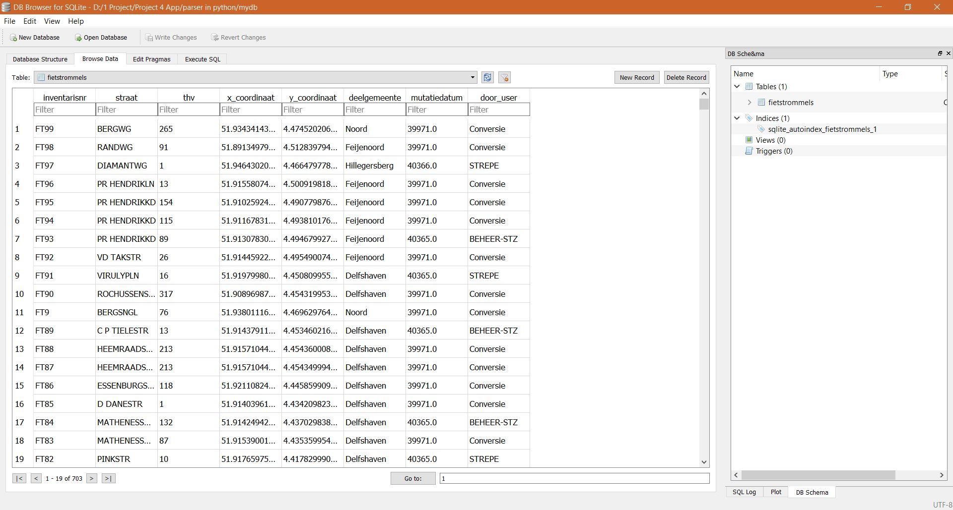
Database

Slide 4
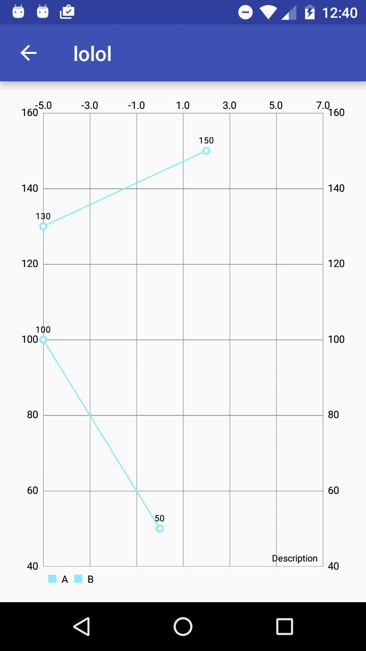
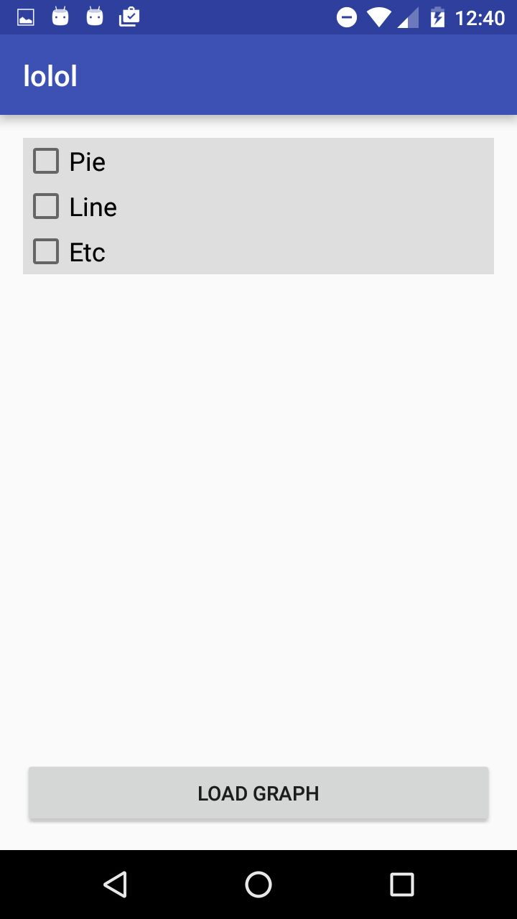
The idea

Slide 5
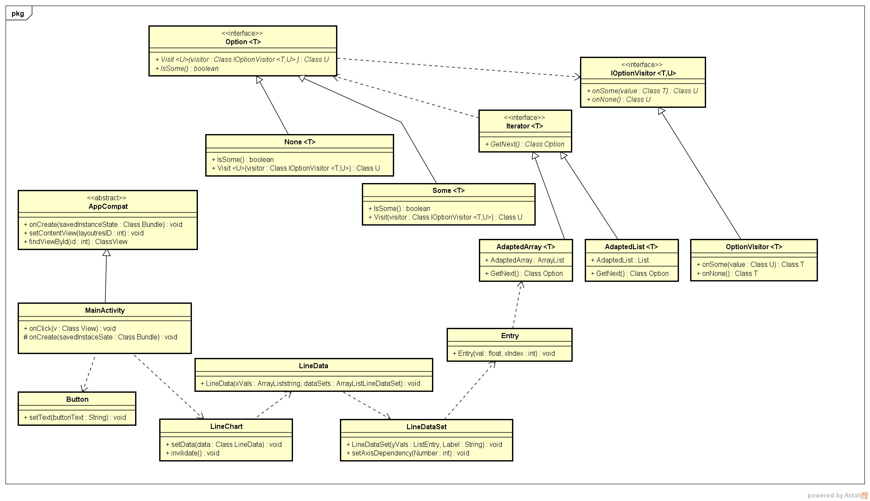
Class Diagram

Slide 6
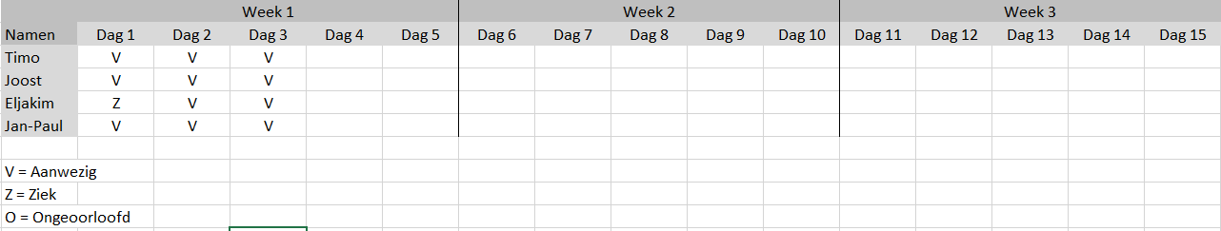
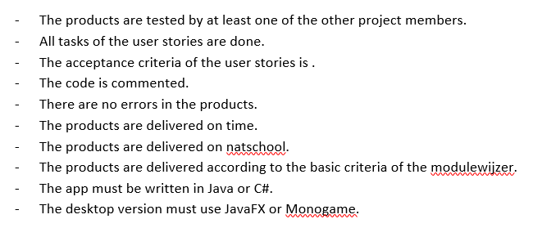
Documentatie
Aanwezigheidstabel:
Definition of Done:

Slide 7
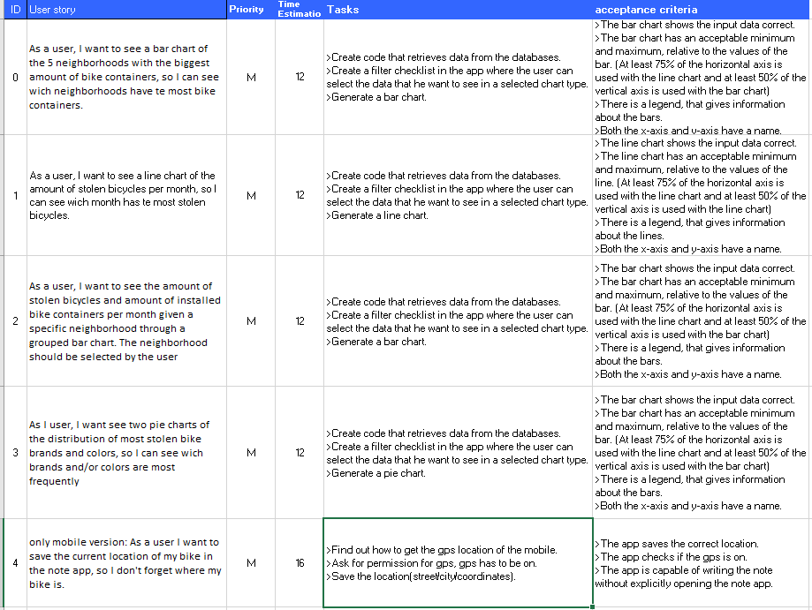
Sprint backlog

Slide 8
Any questions?

